Slide 1
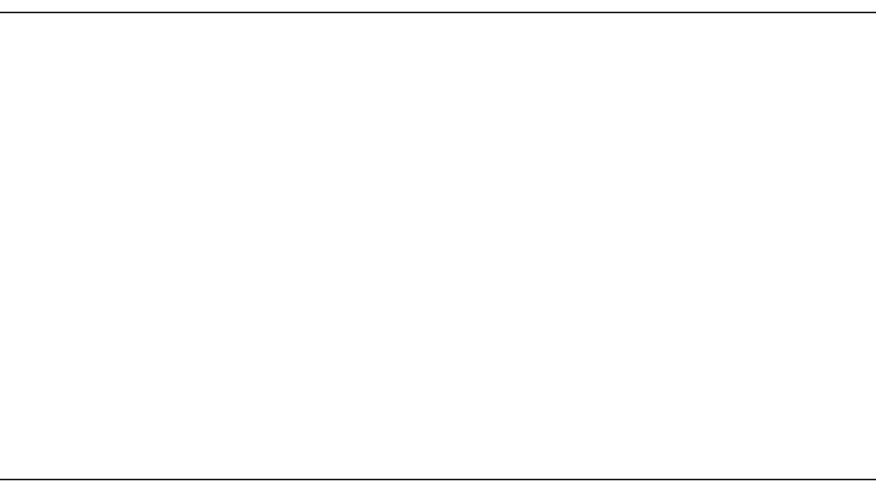
Hymn #395
“O Morning Star, How Fair and Bright”

Slide 2
1.
O Morning Star, how fair and bright!
You shine with God’s own truth and light,
Aglow with grace and mercy!

Slide 3
Of Jacob’s race, King David’s son,
Our Lord and master, You have won
Our hearts to serve You only!

Slide 4
Lowly, holy! Great and glorious,
All victorious, Rich in blessing!
Rule and might o’er all possessing!

Slide 5
2.
Come, heav’nly Bridegroom, Light divine,
And deep within our hearts now shine;
There light a flame undying!

Slide 6
In Your one body let us be
As living branches of a tree,
Your life our lives supplying.

Slide 7
Now, though daily Earth’s deep sadness
May perplex us And distress us,
Yet with heav’nly joy You bless us.

Slide 8
3.
Lord, when You look on us in love,
At once there falls from God above
A ray of purest pleasure.

Slide 9
Your Word and Spirit, flesh and blood
Refresh our souls with heav’nly food.
You are our dearest treasure!

Slide 10
Let Your mercy Warm and cheer us!
O draw near us! For You teach us
God’s own love through You has reached us.

Slide 11
4.
Almighty Father, in Your Son
You loved us when not yet begun
Was this old earth’s foundation!

Slide 12
Your Son has ransomed us in love
To live in Him here and above:
This is Your great salvation.

Slide 13
Alleluia! Christ the living,
To us giving Life forever,
Keeps us Yours and fails us never!

Slide 14
5.
O let the harps break forth in sound!
Our joy be all with music crowned,
Our voices gladly blending!

Slide 15
For Christ goes with us all the way-
Today, tomorrow, ev’ry day!
His love is never ending!

Slide 16
Sing out! Ring out! Jubilation!
Exultation! Tell the story!
Great is He, the King of Glory!

Slide 17
6.
What joy to know, when life is past,
The Lord we love is first and last,
The end and the beginning!

Slide 18
He will one day, oh, glorious grace,
Transport us to that happy place
Beyond all tears and sinning!

Slide 19
Amen! Amen! Come, Lord Jesus!
Crown of gladness! We are yearning
For the day of Your returning!
© 1978 Lutheran Book of Worship.
Used by permission:
LSB Hymn License
.NET, no. 100011038.

